Slide 1
Game Site
Cayce Harwood – CIT190

Slide 2
Target Audience
People interested in strategy or reaction-based games
Interactive Features
Main menu “shooting gallery”
Mouseover descriptions of each game

Slide 3
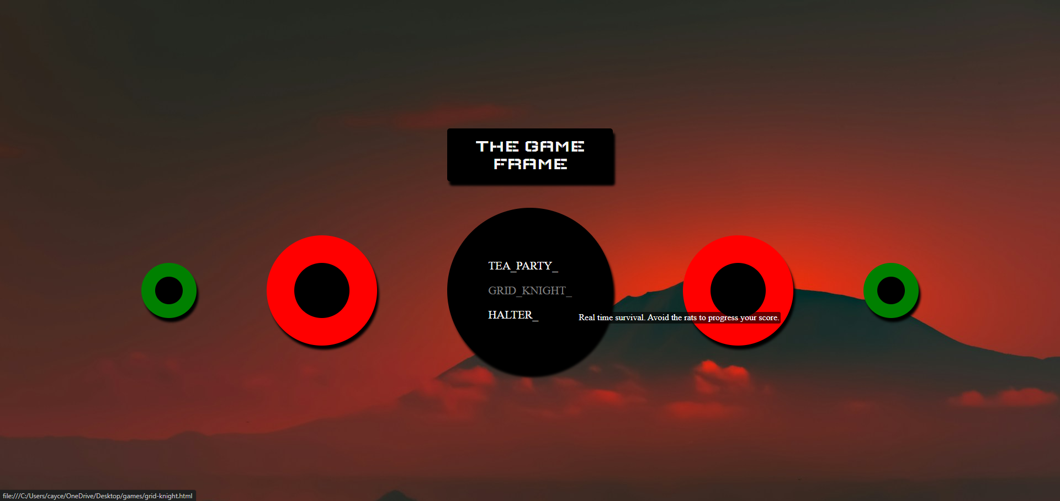
The surrounding circles are mapped with code to change color and play a sound quip when clicked

Slide 4
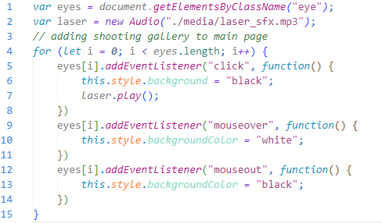
“target” code
Defines an array object with every element in the “eye” class
Imports laser SFX
Iterates through array object, adding necessary styles; plays audio on click

Slide 5
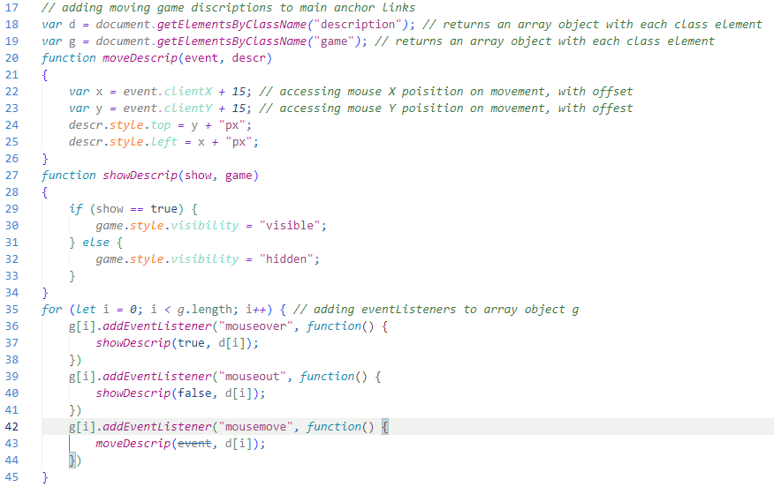
Mouseover description code
Creates object arrays accessing game descriptions and game links (descriptions are inherently hidden)
Creates a function to find mouse position, then alter description pos. in real time
Creates function to alter description visibility
Loops through array objects, adding mouse event listeners

Slide 6

Use of flex containers for responsive design
Circular elements will narrow as viewport size shrinks. At smaller viewport sizes, elements may begin to appear elliptical…

Slide 7
design
Color scheme relies on red and black, with a complementary green to balance
Mountain background gives elements a sense of profound depth
Box shadows give depth to elements, making them appear close
Elements are circular to appear organic/naturally occurring
Text remains plain to appeal to a timeless design
Elements are spaced evenly to appeal to symmetry

Slide 8
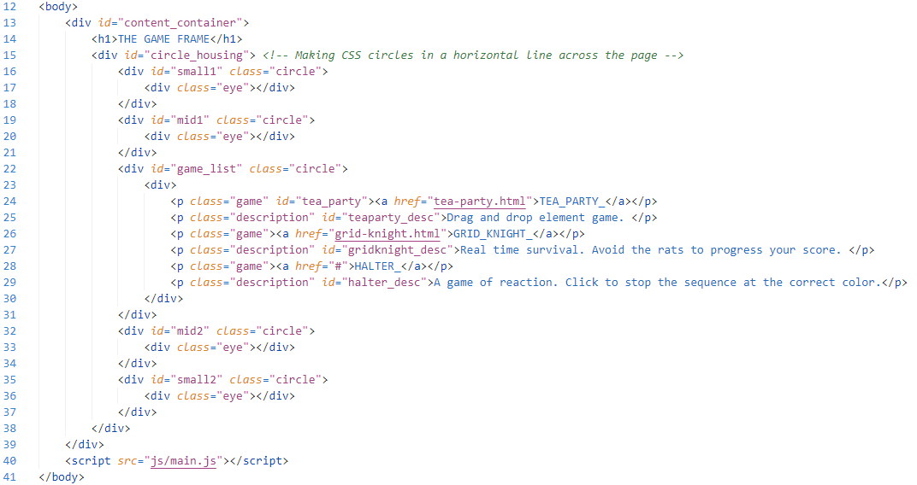
HTML CODE Solution

Slide 9
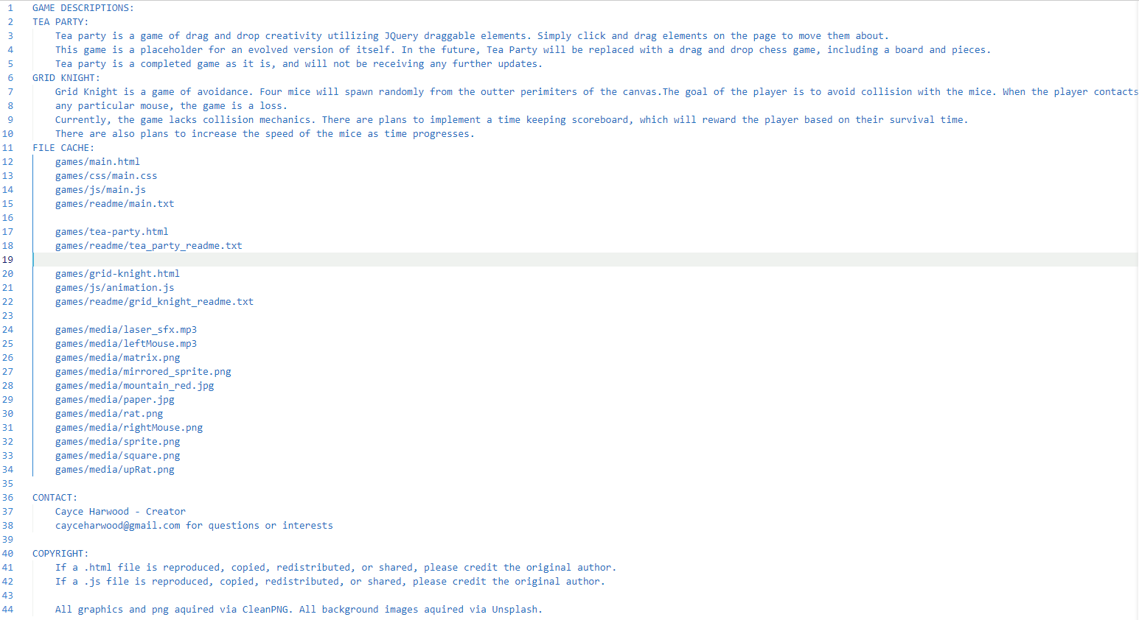
README.TXT​

Slide 10
Effective delivery techniques​
Voice modulation is a powerful tool in public speaking. It involves varying pitch, tone, and volume to convey emotion, emphasize points, and maintain interest:
Pitch variation​
Tone inflection​
Volume control
Effective body language enhances your message, making it more impactful and memorable:
Meaningful eye contact
Purposeful gestures
Maintain good posture
Control your expressions

Slide 11
Navigating Q&A sessions
Know your material in advance​
Anticipate common questions​
Rehearse your responses
Maintaining composure during the Q&A session is essential for projecting confidence and authority. Consider the following tips for staying composed:​
Stay calm​
Actively listen​
Pause and reflect​
Maintain eye contact

Slide 12
THANK YOU
Brita Tamm​
502-555-0152​
brita@firstupconsultants.com​
www.firstupconsultants.com

